Slide 1
THANK YOU FOR DOWNLOADING!
Hope it helps with your presentations!
In case the embedded fonts don’t work, here are the download links:
Poller One
https://fonts.google.com/specimen/Poller+One
Covered By Your Grace https://fonts.google.com/specimen/Covered+By+Your+Grace
Inter Bold https://www.fontsquirrel.com/fonts/inter

Slide 2
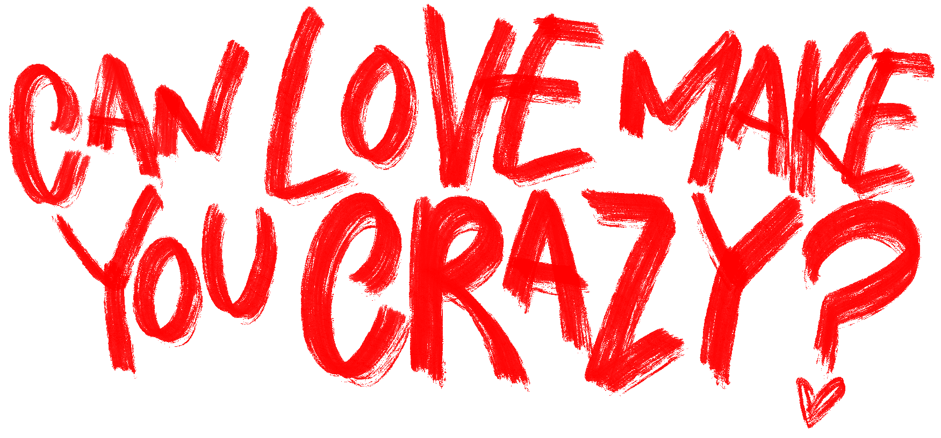
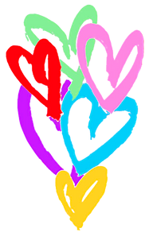
ITZY CRAZY IN LOVE
THE 1ST ALBUM | @DSTORYCO
© 2021 JYP ENTERTAINMENT. ALL RIGHTS RESERVED.

Slide 3





LOVE POTION RECIPE
Phenylethylamine
Norepinephrine
Endorphins
Oxytocin
Dopamine
*** 5ml
*** 4ml
*** 3ml
*** 2ml
*** 2ml

Slide 4
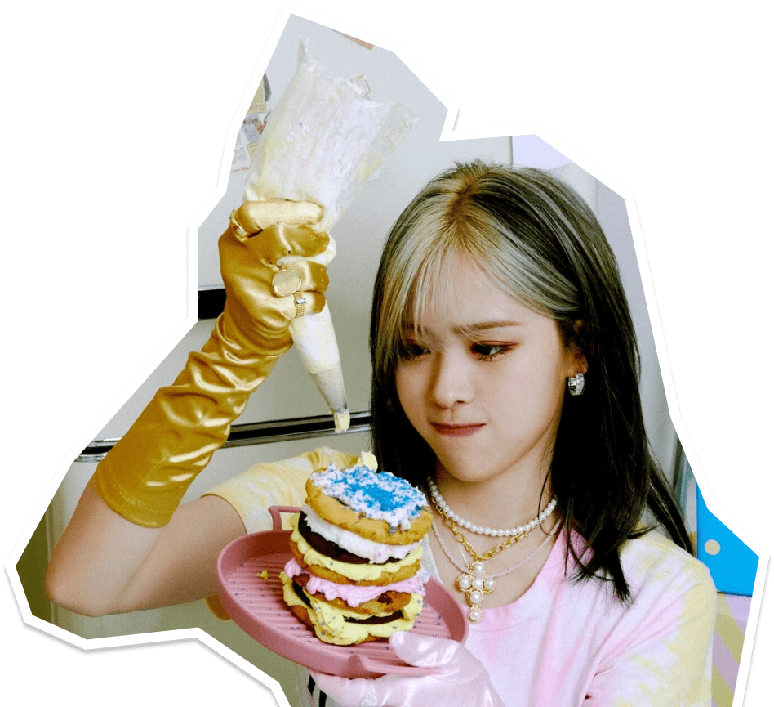





PHYSICAL RESPONSES
SWEATY
DILATED PUPILS
PALMS
FLUSHED
RACING
CHEEKS
HEART
BUTTERFLIES

Slide 5
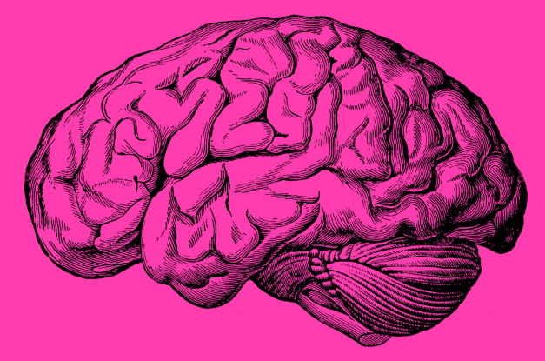

NEW LOVERS HAVE MUCH IN COMMON WITH ADDICTS
NUCLEUS ACCUMBENS
ALSO lights up in cocaine users and gamblers when they act out their addiction

Slide 6
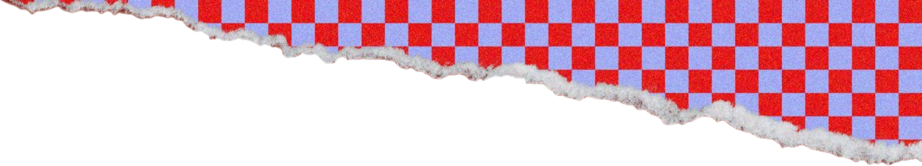
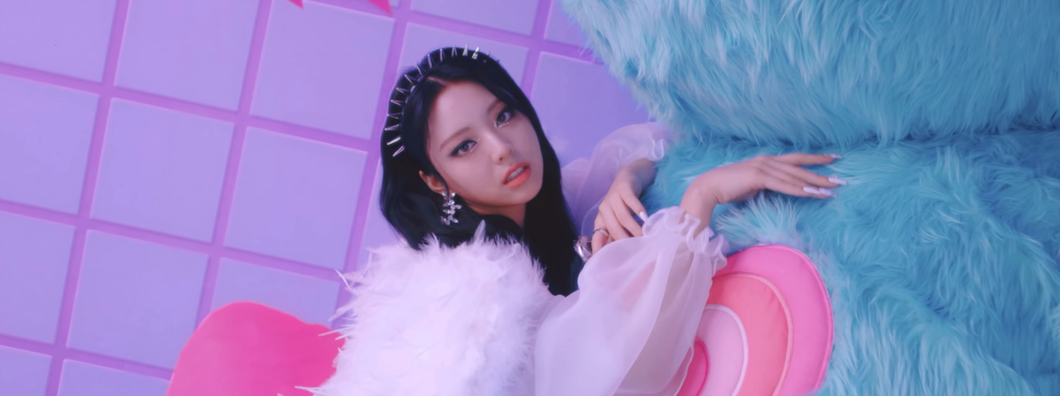

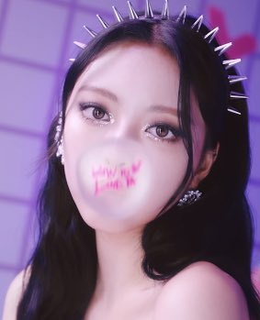
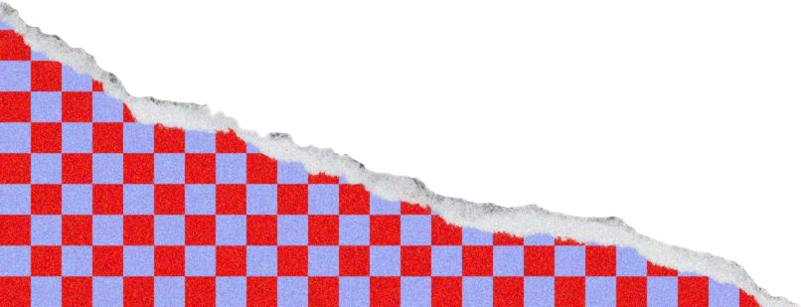
It’s okay to be a little bit selfish
PEOPLE IN LOVE OFTEN EXPERIENCE
EUPHORIA, CRAVINGS, DEPENDENCY, WITHDRAWAL,
AND OTHER BEHAVIOUS ASSOCIATED WITH ADDICTION

Slide 7

LOVE IS
EASY
PATIENT
RESPECT
BLIND
CRUEL
Love deactivates the neural pathways responsible for negative emotions, such as fear and social judgment.

Slide 8
GETTIN'
LOVE HEART XOXO LOCO
GETTIN'
CRAZY IN ⎯⎯⎯⎯⎯ LOVE
OUTTA ⎯⎯⎯⎯ CONTROL ⎯⎯⎯⎯ ♥
LOCO
LOCO
CAN LOVE MAKE YOU CRAZY?

Slide 9
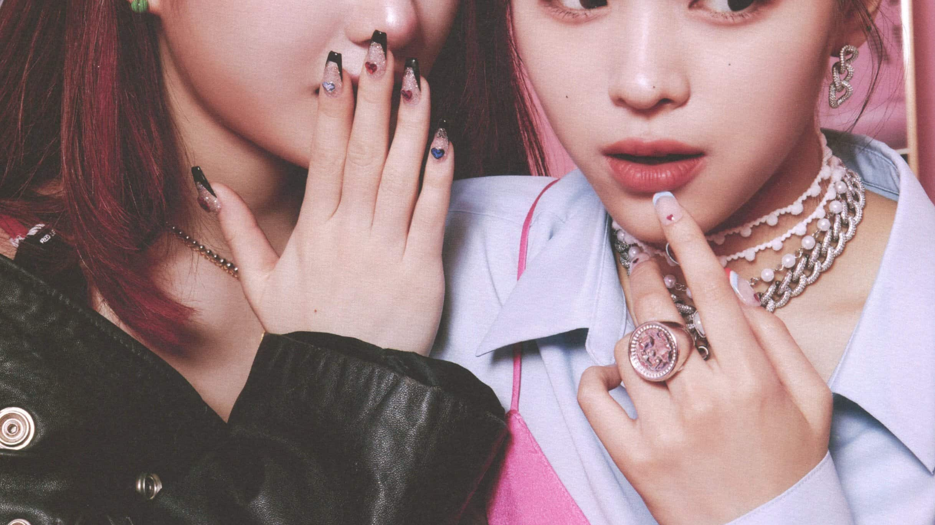
SECTION HEADER

